Slide 1




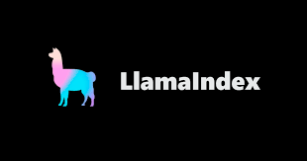


Part 5 – Components to Build LLM-based Web Applications
Quang Duong

Slide 2
What We Will Learn
Components to build LLM-based web-applications
Backend components
LLM orchestration frameworks
Open-source vs Proprietary LLMs
Vector embedding
Vector database
Prompt Engineering
Frontend components
Python-based frontend frameworks

Slide 3
Backend Components for LLM-based Applications

Slide 4
Backend Components for LLM-based Applications
LLM orchestration frameworks
LangChain
LlamaIndex
Open-source vs proprietary LLM
A quick comparation
Usage examples
Vector Embedding
Vector database
Prompt Engineering

Slide 5
LLM Orchestration Frameworks
LangChain
LLamaIndex

Slide 6
LangChain

Slide 7


Why LangChain?
A framework for developing applications powered by language models
Empowers language applications, that
Context-aware: connect a language model to context sources
Prompt instructions
Few shot examples
Content to ground its responses in, etc.
Reason: rely on language model to reason
How to answer based on provided context
What actions to take
Interact with external tools/resources
Diversed LLMs
Hugging Face
Llama
OpenAI
Mistral AI
…
Data sources
Search APIs
and so on

Slide 8
LangChain
LangChain-Core
LangChain-Community/Modules
Base abstractions and LangChain Expression Language (LCEL):
Parallelization
Fallbacks
Tracing
Batching
Streaming
Async
Composition
Third party integrations
Model I/O
Retrieval
Agent Tooling
1
2
3
LangChain
Chains, agents, and retrieval strategies that make up an application's cognitive architecture

Slide 9






LangChain-Community/Modules
Model I/O
Retrieval
Agent Tooling
Model
Prompt
Example Selector
Output Parser
Retriever
Document Loader
Vector Store
Text Splitter
Embedding Model
Tools
Toolkits

Slide 10
How to Use LangChain?
Installation
pip install langchain
LangChain documentation
https://python.langchain.com/v0.2/docs/how_to/

Slide 11
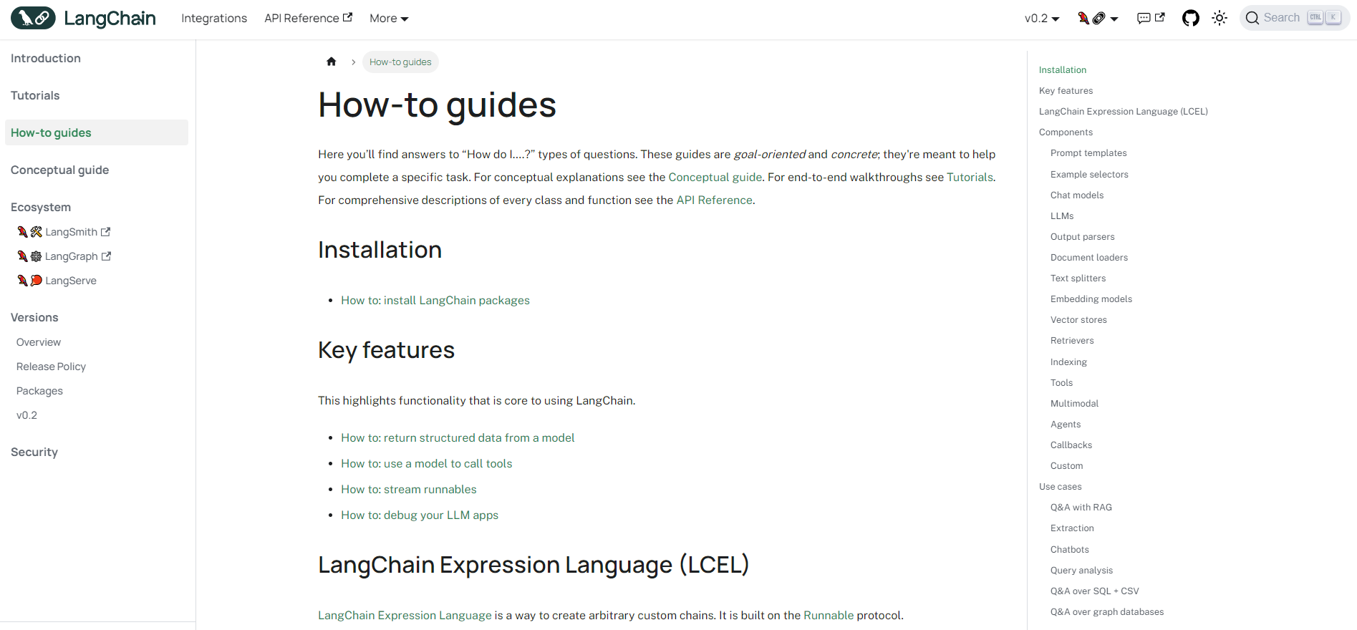
How to Use LangChain?

Slide 12
LangChain's Simple Example
from dotenv import load_dotenv
from langchain.chat_models import ChatOpenAI
from langchain.prompts import ChatPromptTemplate
from langchain.schema import StrOutputParser
# Load the environment variables
load_dotenv()
# Initialize the chat model, i.e. gpt-3.5-turbo
llm = ChatOpenAI(model_name="gpt-3.5-turbo", temperature=0)
# Define the prompt template
prompt_template = """
You are an XXX assistant.
Following is the scenario that you need to respond to:
{request}
"""
# Create a prompt
prompt = PromptTemplate(
input_variables=["request"],
template=prompt_template)
# Create LLM chain
chain = prompt | llm | StrOutputParser()
# Get response
response = chain.invoke({"request":prompt})

Slide 13
LlamaIndex

Slide 14
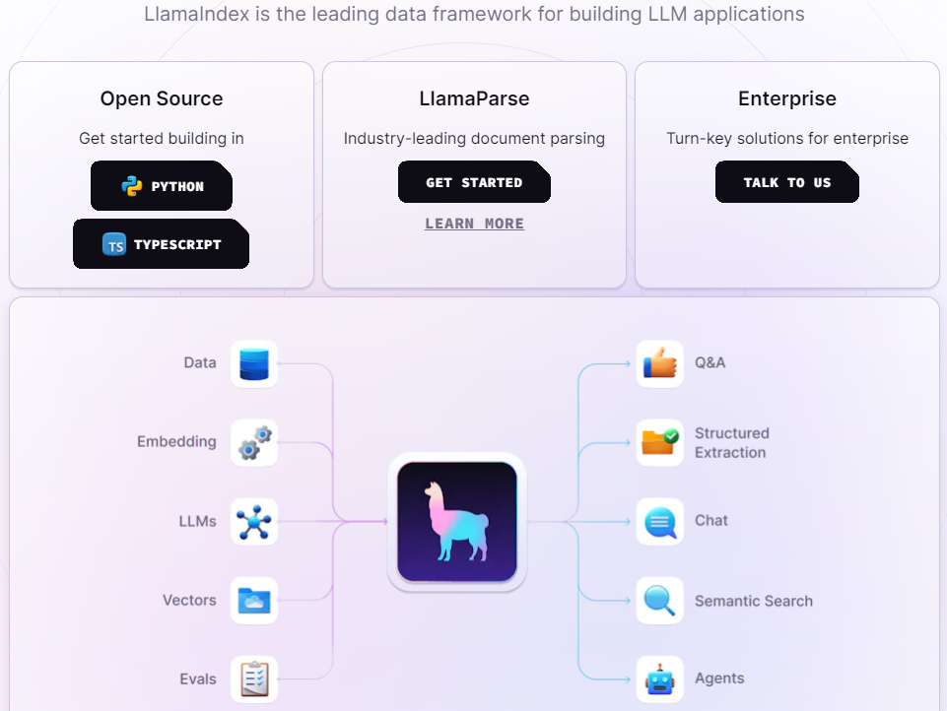
Why LlamaIndex?
https://www.llamaindex.ai/
LlamaIndex focuses on LLM applications for documents, i.e. RAG use cases.

Slide 15
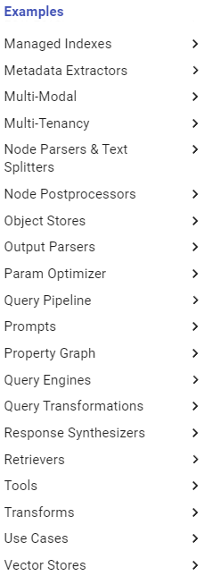
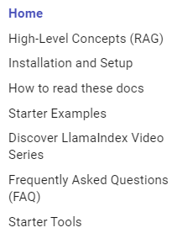
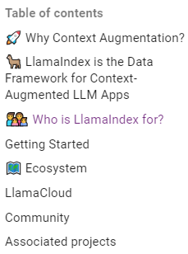
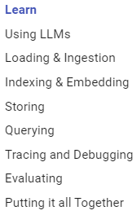
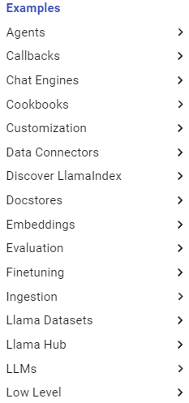
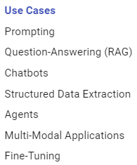
How-to Guides LlamaIndex
https://docs.llamaindex.ai/en/stable/

Slide 16
LlamaIndex's Simple Example
import nltk
import pandas as pd
from dotenv import load_dotenv
from llama_index import VectorStoreIndex, SimpleDirectoryReader
# Load environment variables from a .env file
load_dotenv()
# Download the Punkt tokenizer for sentence splitting
nltk.download("punkt")
# Define the data source path
DATASOURCE_DIR = "./datasource"
def query_engine(query):
# Load the documents from the directory
documents = SimpleDirectoryReader(DATASOURCE_DIR).load_data()
# Create an index from the documents
index = VectorStoreIndex.from_documents(documents)
# Persist the index for later use
index.storage_context.persist()
# Create a query engine from the index
query_engine = index.as_query_engine() # Execute the query
response = query_engine.query(query)
# Return the response and the DataFrame
return response
# QA
question = "What is the geography of Paris?"
response= query_engine(question)

Slide 17
Open-source vs Proprietary LLMs

Slide 18
Open-source vs Proprietary LLMs
Open-source LLMs
Proprietary LLMs
Shared publicly in Hugging Face Hub, GitHub or other platforms.
With source-code included or open-weights only.
With appropriate licenses:
for research,
with or without commercial usage, etc.
Examples
Llama 2, 3 of Meta AI,
Mistral,
OLMo, etc.
Neither weights nor source-code are shared publicly.
Payment for use
Examples:
OpenAI: GPT-4, GPT-4o
Anthropic: Claude 3.5

Slide 19
Usage Examples
Open-source LLMs
Proprietary LLMs
from transformers import AutoTokenizer, pipeline
from langchain.llms.huggingface_pipeline import HuggingFacePipeline
# Get model name
model = "meta-llama/Llama-2-7b-chat-hf"
# Load the tokenizer for the model
tokenizer = AutoTokenizer.from_pretrained(model)
# Define the text generation pipeline
text_pipeline = pipeline(
"text-generation",
model=model,
tokenizer=tokenizer
)
# Create a HuggingFacePipeline with the text generation pipeline and model kwargs
llm = HuggingFacePipeline(pipeline=text_pipeline, model_kwargs={"temperature": 0})
from dotenv import load_dotenv
from langchain.chat_models import ChatOpenAI
# Load environment variables, i.e. OPENAI_API_KEY
load_dotenv()
# Initialize the chat model, i.e. gpt-4o
llm = ChatOpenAI(temperature=0, model_name="gpt-4o")

Slide 20
Vector Embedding

Slide 21
Vector Embedding
Why vector embedding?
What is the vector embedding process?
How does pre-trained embedding model capture semantic meaning of words?
How to choose an embedding model?

Slide 22
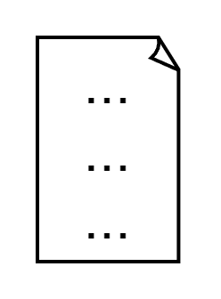



Why Vector Embedding?
Text data
Text classification
Text generation
Translation
Question-Answering
Summarization
Embedding
LLM
0.01
0.02
…
0.02
0.02
0.03
…
0.01
Numerical vectors that represent text data

Slide 23
What Is the Vector Embedding Process?
Vector embedding process
Creating a numerical representation of words, sentences, or even entire documents
Capturing the semantic and syntactic meanings between words
Enabling algorithms to comprehend their contextual meaning and reason with
Inputs:
Words, or sentences or entire document
Outputs:
High-dimensional vectors, a long sequence of continuous values
cool
Embedding model
0.102
0.004
0.001
…
0.002
Text
High-dimensional vector

Slide 24
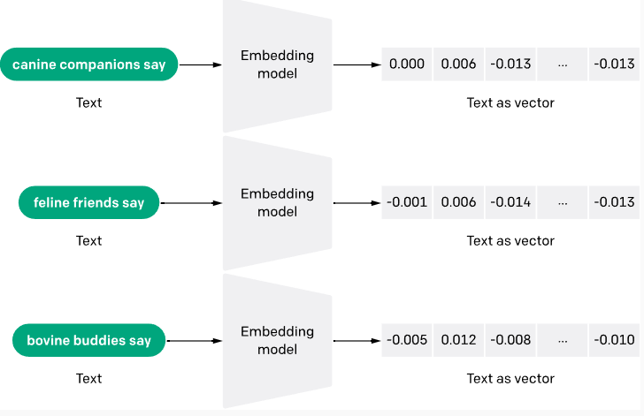
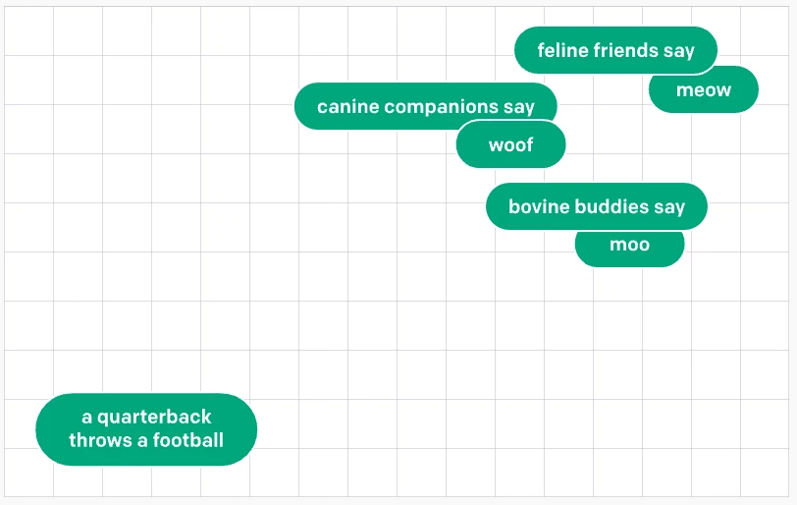
Pre-trained Embedding Model
How does pre-trained embedding model capture semantic meaning of words?
Trained on a large corpus of text
Model assigns vectors to words or sequences of words
Adjust model's weights so that the vectors reflect their semantic similarity and context, e.g. synonym, analogy, gender, sentiment, etc.
I.e. minimize the distance between similar words, and vice-versa.
https://openai.com/index/introducing-text-and-code-embeddings/

Slide 25
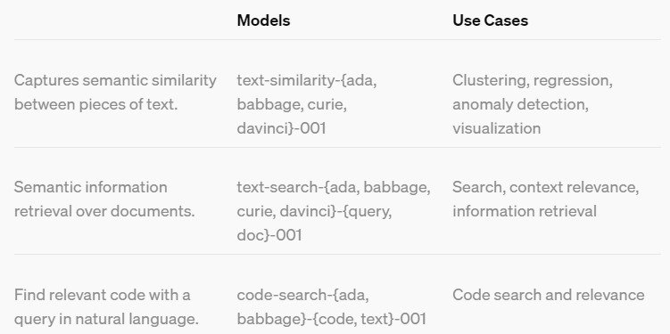
How to Choose an Embedding Model?
By model types:
Open-sourced embedding models
Hosted in Hugging Face or other platforms
Fine-tune open-sourced embedding models on domain-specific data
Proprietary embedding models
Via API, like OpenAI's Embedding models
By down-stream tasks
Classification, retrieval, summarization, etc.
By language
English, French, …
OpenAI's embedding model guides [*]
[*] https://openai.com/index/introducing-text-and-code-embeddings/

Slide 26
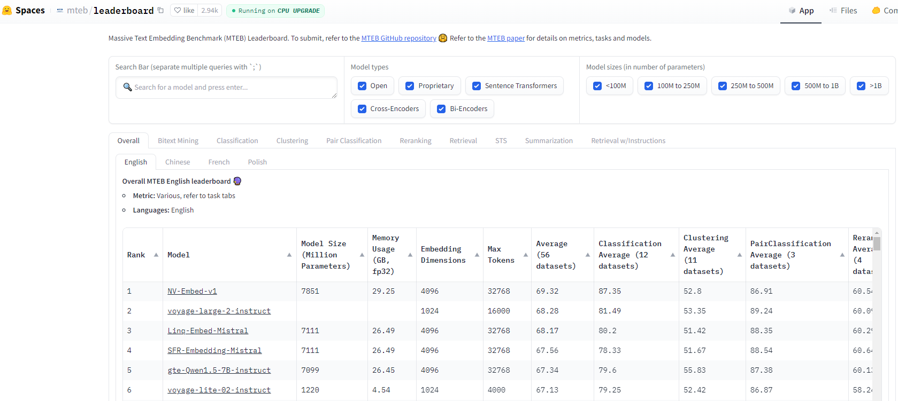
How to Choose an Embedding Model?
MTEB: Massive Text Embedding Benchmark

Slide 27
Vector Database

Slide 28
Vector database
What is a vector database?
The landscape of vector database providers

Slide 29
What Is a Vector Database?
It is a database
To store on high-dimensional vectors
To perform operations e.g. similarity or semantic search
These vectors are
mathematical representations of features or attributes derived from raw data, like raw text data, etc.
obtained by embedding process
Vector database
Document 1
Embedding model
0.102
0.004
…
0.002
Document N
Embedding model
0.002
0.003
…
0.001

Slide 30
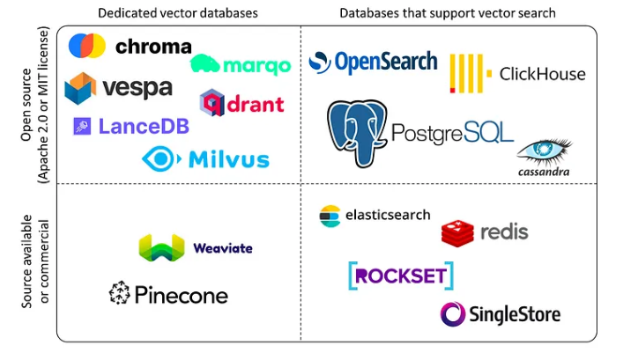
Vector Database Providers
Source: https://blog.det.life/why-you-shouldnt-invest-in-vector-databases-c0cd3f59d23c

Slide 31
Creating Vector DB Code Snippets
from dotenv import load_dotenv
from langchain.vectorstores.chroma import Chroma
from langchain.embeddings import OpenAIEmbeddings
# Load environment variables, i.e. OPENAI_API_KEY
load_dotenv()
# Create a Chroma vector store from the chunks of text
# Use OpenAIEmbeddings to embed the chunks of text
vectorstore = Chroma.from_documents(documents=texts, embedding=OpenAIEmbeddings())
from dotenv import load_dotenv
from langchain.vectorstores.faiss import FAISS
from langchain.embeddings import OpenAIEmbeddings
# Load environment variables, i.e. OPENAI_API_KEY
load_dotenv()
# Create a FAISS vector store from the chunks of text
# Use OpenAIEmbeddings to embed the chunks of text
vectorstore = FAISS.from_documents(documents=texts, embedding=OpenAIEmbeddings())
With LangChain, OpenAIEmbedding, & Chroma
With LangChain, OpenAIEmbedding, & FAISS

Slide 32
Prompt Engineering

Slide 33
Prompt Engineering
What are prompt and prompt engineering for LLMs?
Prompt components
Basic prompt engineering
Advanced prompt engineering

Slide 34


Prompt vs Prompt Engineering
Prompts
Sets of instructions that are used to guide the LLMs in generating desired responses
Prompt Engineering
Different techniques / strategies to optimize the prompts to obtain desired responses from LLMs
Inputs
Outputs
Prompts
LLMs

Slide 35
Prompt Components
Context
Provides background information for the model to understand the user's request
Can be as simple as a single sentence of as complex as a paragraph or more.
Instruction
How the model should respond to the user's input, e.g., step-by-step response, present summary at the end of the response, etc
Optional parameters / constraints
E.g., desired format (json, dict, …), tone, length of the response, etc.
User query / questions
About which information should be given in the response

Slide 36
Prompt Example
Introducing our latest game-changer in the world of skincare – an Organic and Natural Face Care line! 🌿🌸 Say goodbye to harsh chemicals and hello to the pure, gentle power of nature. Our products are meticulously crafted with the finest organic ingredients to rejuvenate and pamper your skin. 💆‍♀️✨ Experience the magic of botanical extracts that soothe, hydrate, and nourish, leaving your skin radiant and refreshed. What sets our Face Care apart is its eco-conscious packaging, promoting a sustainable approach to beauty. 🌱 Join us on this eco-friendly journey towards healthier, more radiant skin. We're committed to bringing you a skincare regime that's not only good for you but also for our planet. 🌎✅ Discover the difference that nature's goodness can make. 🌟 #NaturalSkincare #OrganicBeauty #EcoFriendly #GlowNaturally
Context
You are a marketing manager for new product launch.
Write a short paragraph to promote new product on social media platform.
Instruction
Your response should be no more than 200 words and should focus on unique features of the product
ChatGPT
GPT-3.5
Constrain
Query
The new product is organic and natural face care.
Prompts

Slide 37
Basic Prompt Engineering
"Be clear and specific instructions"
Use delimiters:
Mark the beginning and end of instructions, e.g. triple quotes """ """, triple backtick ``` ```, etc.
Specific structured output:
JSON, HTML, etc.
Provide contextual instructions
context, assumption, condition
Give examples:
One shot or few-shot prompting
Role
Assign a role

Slide 38
Use Delimiter
prompt_template = """
Write a short and concise summary of the following text in triple backsticks
TEXT: ```{text}```
SUMMARY:
"""

Slide 39
Giving Specific Instructions
General
vs
Specific & precise
Write a paragraph about the benefits of exercise.
Compose a concise comparison between the advantages of aerobic exercise and strength training.
Regular exercise enhances overall well-being by improving cardiovascular health, boosting mood, and maintaining a healthy weight.
Aerobic exercise promotes cardiovascular health through increased oxygen consumption, while strength training builds muscle mass, aiding metabolism for efficient weight management.

Slide 40
Structured Output
General
vs
Structured output
Given a customer review: 'I love this product'. Determine the sentiment and give a 20-word email response
Given a customer review: 'I love this product'. Determine the sentiment and give a 20-word email response. Return your response in Json object with two keys: sentiment and response email.
Sentiment: Positive
Email Response: "Thank you for your kind words! We're thrilled to hear that you love our product. Your satisfaction means the world to us.
{
"sentiment": "Positive",
"response_email": "Thank you! We're delighted you love our product. Your satisfaction is our priority. Let us know if you need anything else!"
}

Slide 41
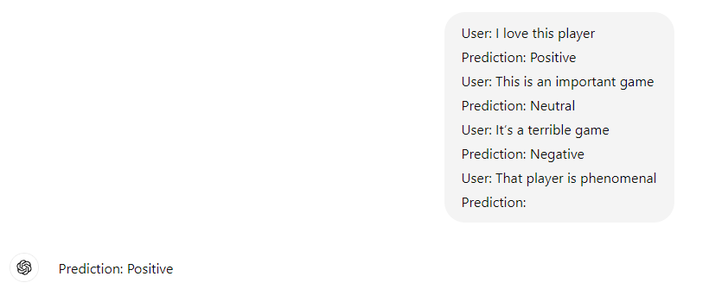
Few-shot Prompting

Slide 42
Role Prompting
You are a customer support representative for a tech company. A customer is experiencing issues with their software. Respond as you would in this role
You are a science fiction author. Create a short story set in a futuristic world where humans have colonized other planets.
You are a travel blogger. Share your experiences and recommendations for a dream vacation in a tropical paradise.
You are a gourmet chef. Describe the preparation and presentation of your signature dish, highlighting the ingredients and techniques used.
You are Abraham Lincoln during the Civil War. Write a letter to your generals outlining your strategy and vision for the Union.
You are a licensed psychologist. Provide advice and guidance to someone struggling with anxiety and stress.

Slide 43
Advanced Prompt Engineering
Chain of Thought (CoT)
Providing intermediate reasoning steps to guide the model's responses
"Let's think step by step"
A series of manual demonstrations, each composed of a question and a reasoning chain that leads to an answer
Retrieval Augmented Generation (RAG)
Incorporating up-to-date external knowledge into the model's input
Reduce hallucinations
Other methods
Self-consistency
Generated knowledge
Least-to-most prompting
Tree of thoughts
Graph of thoughs

Slide 44
RAG Prompting
prompt_template = """
You are an assistant for question-answering tasks. Use the following pieces of retrieved context to answer the question.
If you don't know the answer, just say that you don't know.
Question: {question}
Context: {context}
Answer:
"""

Slide 45
Frontend Frameworks for LLM-based Applications

Slide 46
Frontend Frameworks
For web applications
with JavaScript
React, Vue.js, …
with Python
Streamlit
Gradio

Slide 47
Streamlit

Slide 48
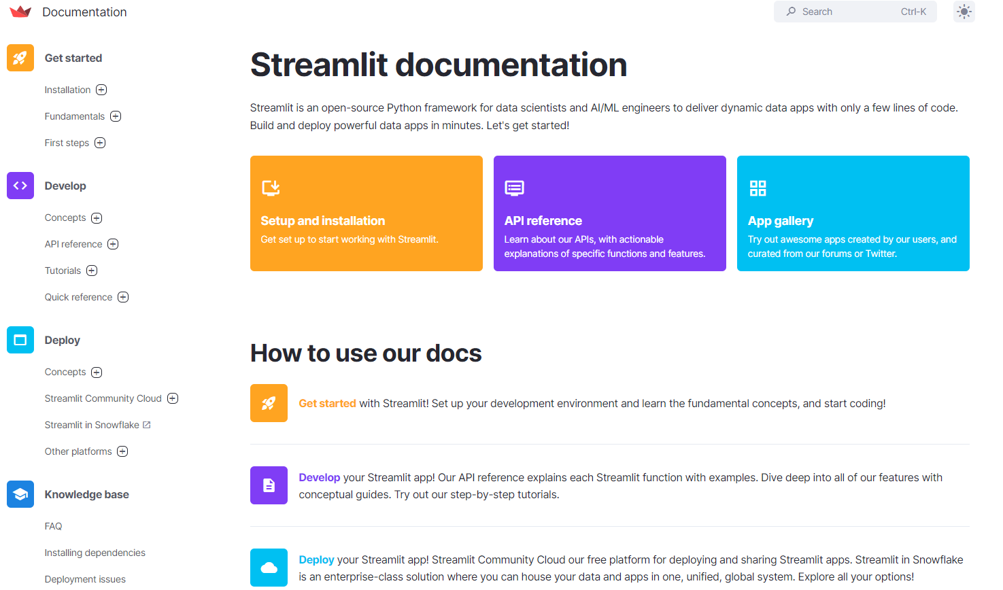
Streamlit
https://streamlit.io/

Slide 49
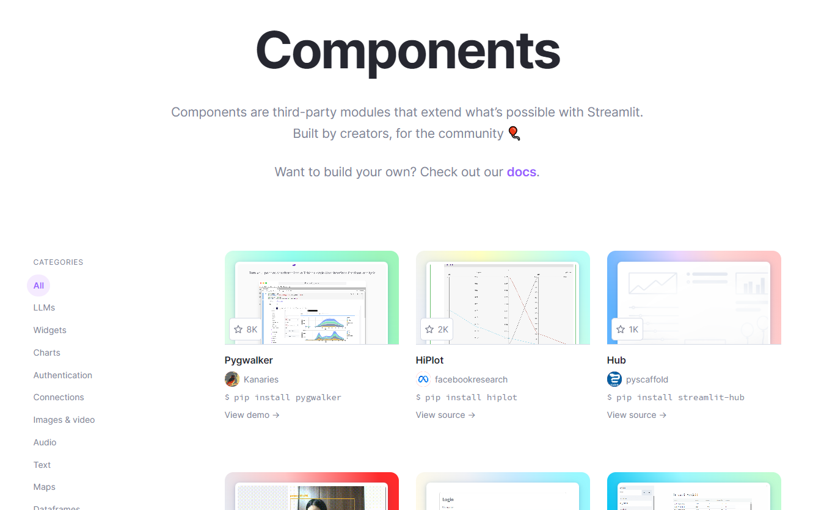
Streamlit Components

Slide 50
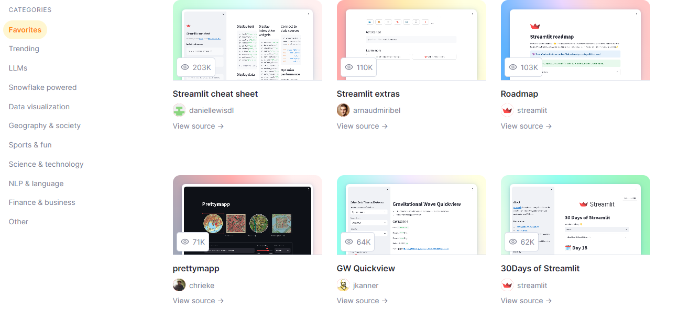
Streamlit Gallery

Slide 51
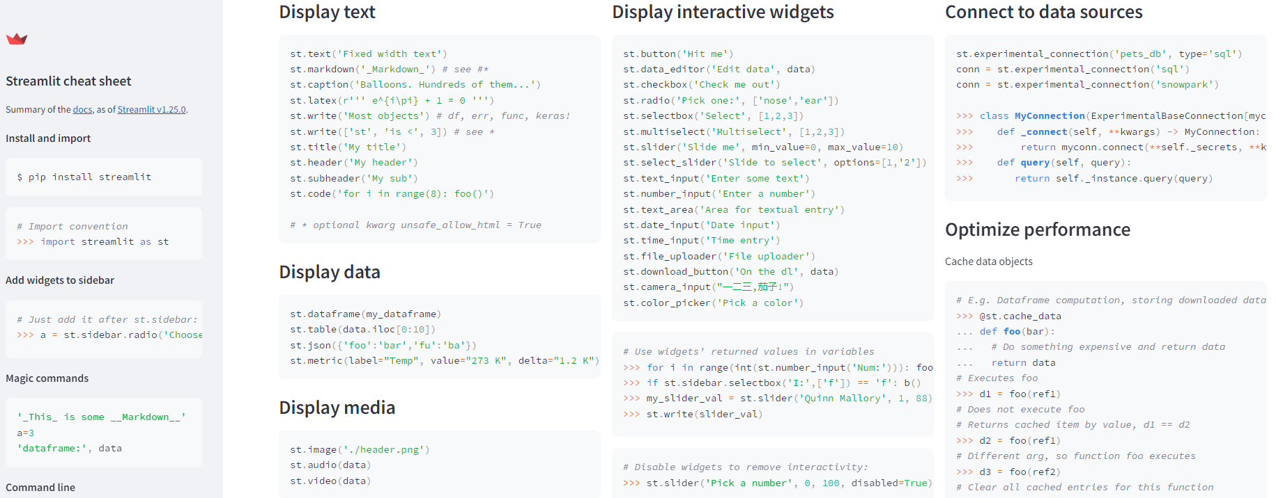
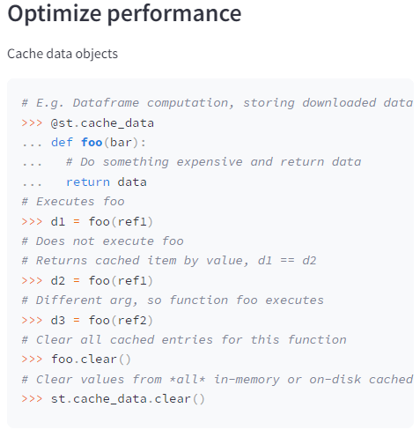
Streamlit Cheat Sheet
https://cheat-sheet.streamlit.app/
…

Slide 52

Show Logos and Headers in Streamlit
import streamlit as st
def app():
st.set_page_config(page_title="GenAI", page_icon=COMPANY_LOGO_PATH, layout="wide")
c1, c2, c3 = st.columns([1, 5, 1], gap="small")
with c1:
st.image(PRODUCT_LOGO_PATH, use_column_width=True)
with c2:
st.markdown(HEADER, unsafe_allow_html=True)
with c3:
st.image(COMPANY_LOGO_PATH, use_column_width=True)
if __name__ == "__main__":
app()

Slide 53
Gradio

Slide 54
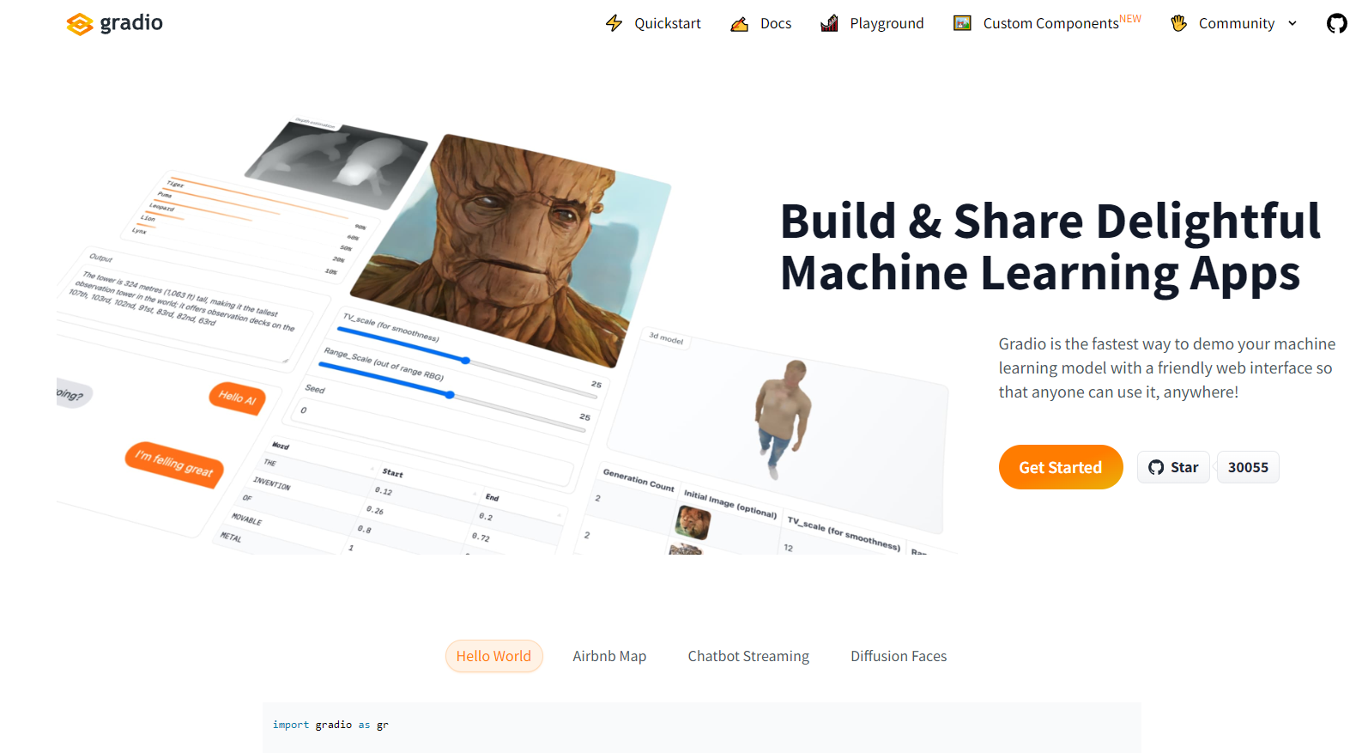
Gradio
https://www.gradio.app/

Slide 55
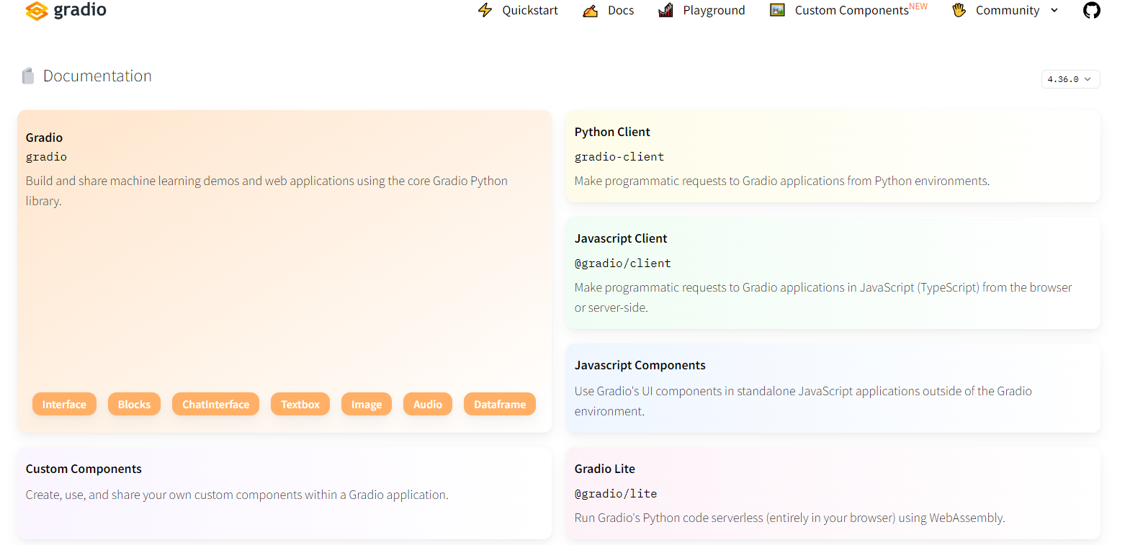
Gradio's Documentation

Slide 56
Some Simple Demos with Gradio

Slide 57
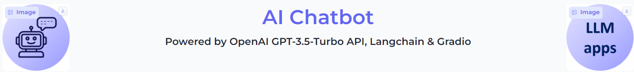
Blocks, Row, Image, HTML
import gradio as gr
# Create a Gradio interface with a soft theme
demo = gr.Blocks(theme="soft")
# Add elements to the interface
with demo:
# Add a row with the product logo, header, and company logo
with gr.Row():
gr.Image(PRODUCT_LOGO_PATH, scale=0) # Product logo
gr.HTML(HEADER) # Header
gr.Image(COMPANY_LOGO_PATH, scale=0) # Company logo

Slide 58
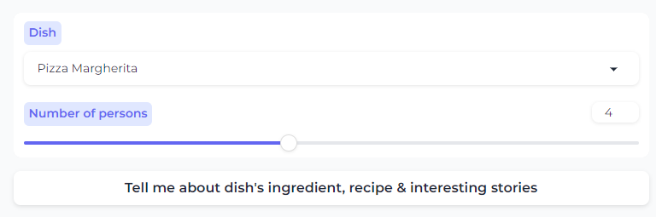
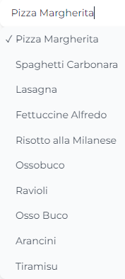
Column, Dropdown, Slider, Button
with gr.Column():
# Create a dropdown
dish = gr.Dropdown([
"Pizza Margherita",
"Spaghetti Carbonara",…
], label="Dish",
value="Pizza Margherita",)
# Create a slider
no_per = gr.Slider(minimum=1, maximum=8, value=2, step=1, label="Number of persons")
# Create a button
tellme_btn = gr.Button( "Tell me about dish's ingredient, recipe & interesting stories")

Slide 59
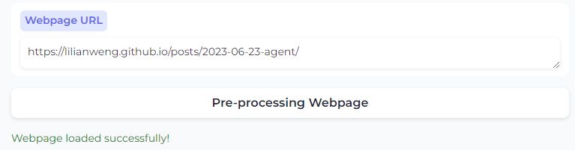
Textbox, Markdown Blocks
with gr.Column():
# Create a textbox
url_webpage = gr.Textbox(
value="",
placeholder="Add webpage URL",
label="Webpage URL",
lines=1,
interactive=True,)
# Create a button
load_page_bt = gr.Button("Pre- processing Webpage")
# Create a markdown component to display the status
langchain_status = gr.Markdown("")

Slide 60
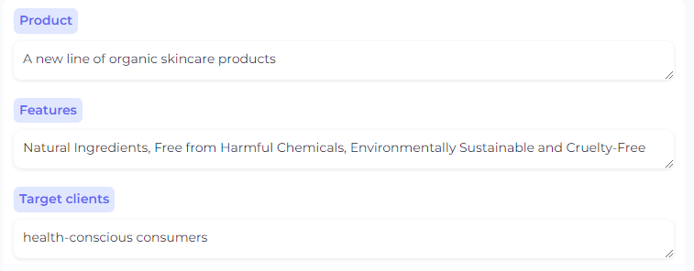
Textbox Blocks for Multi-Inputs as Texts
with gr.Column():
# Create textbox for product
product = gr.Textbox(
label="Product",
placeholder="Enter product",
lines=1, value="", interactive=True,)
# Create textbox for product features
features = gr.Textbox(
label="Features",
placeholder="Enter features",
lines=1, value="", interactive=True,)
# Create textbox for target clients
target_clients = gr.Textbox(
label="Target clients",
placeholder="Enter target clients",
lines=1, value="", interactive=True,)

Slide 61
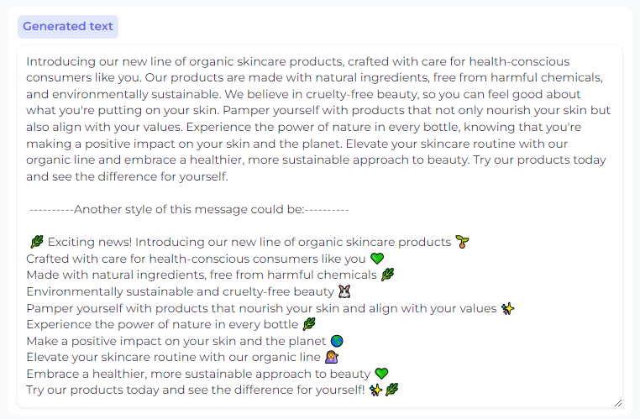
Textbox Block for Displaying Responses
# Create a textbox for displaying the generated text
output_text = gr.Textbox(
label="Generated text",
placeholder="Generated text will appear here",
lines=10,
value="",
interactive=False,)

Slide 62

Upload Block
# Add a file upload component
document_file = gr.File(
label="Upload a document",
file_types=[".pdf", ".docx", ".txt"],
type="filepath",)

Slide 63
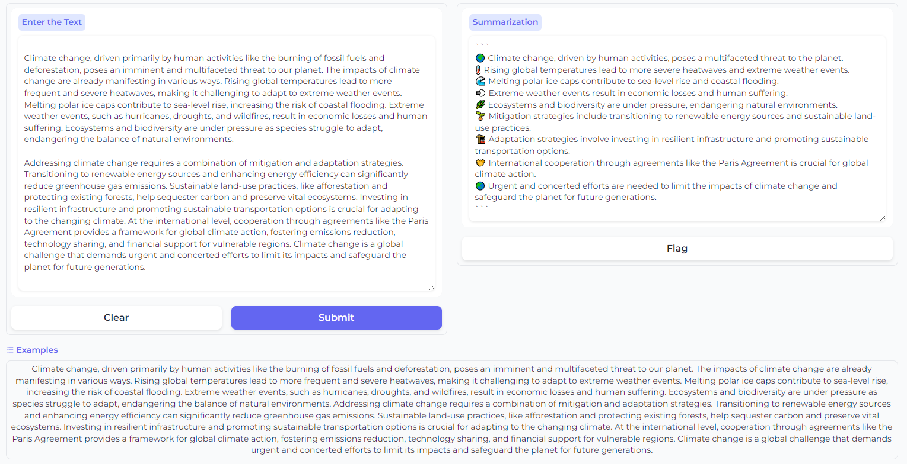
Interface Block
# Set up the input textbox
inputs = gr.Textbox(lines=10, label=" Enter the Text", max_lines=20)
# Set up the output textbox
outputs = gr.Textbox(lines=5, label="Summarization")
# Create the Gradio interface
gr.Interface(
fn=prediction,
inputs=inputs,
outputs=outputs,
theme="soft",
examples=[EXAMPLE_TEXT],
)

Slide 64
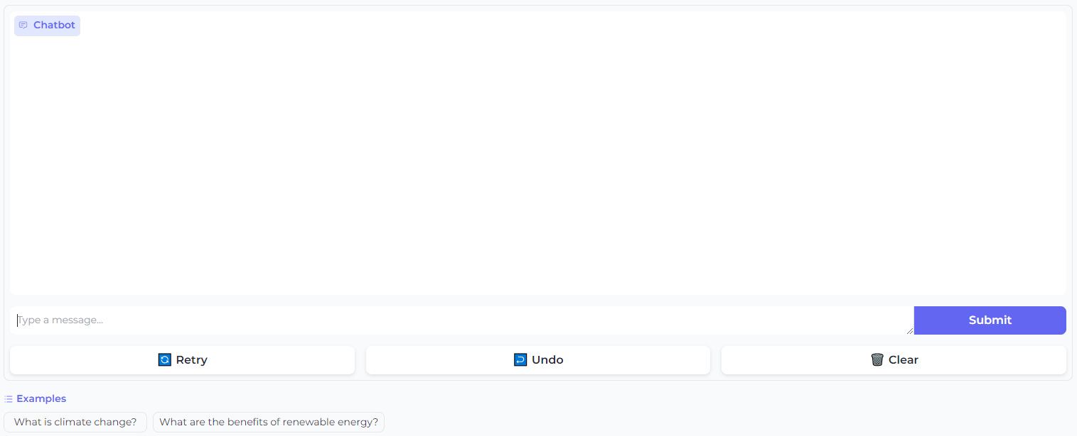
Chat Interface Block
gr.ChatInterface(
predict,
examples=["What is climate change?", "What are the benefits of renewable energy?"],
)

Slide 65
What We Have Learned

Slide 66
In summary
Introduced to components to build LLM-based web applications
LLM orchestration frameworks: LangChain, LlamaIndex
Open-source vs proprietary LLMs
Vector Embedding
Vector database
Prompt Engineering
Python frameworks to build quick LLM applications: Streamlit, Gradio
Simple demos, source-code examples

